Slide 1

ASP.NET Core Advanced

Slide 2
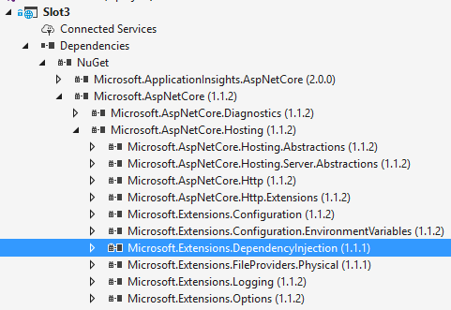
Dependency injection out of the box

Slide 3
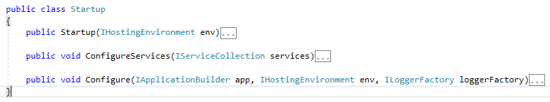
DI anything
Notes:
Startup class wird über DI aufgelöst

Slide 4
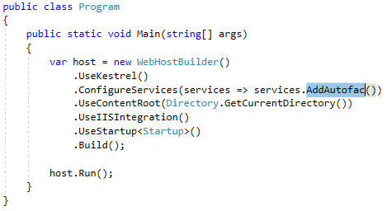
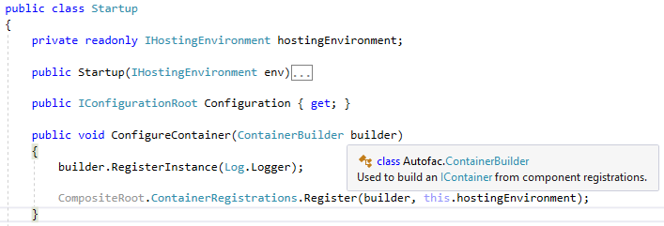
Use YoUr Fav IoC Container

Slide 5
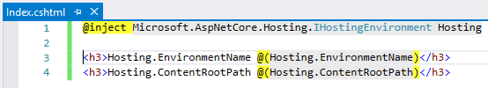
DI into View
Notes:
http://localhost/RazorDI

Slide 6
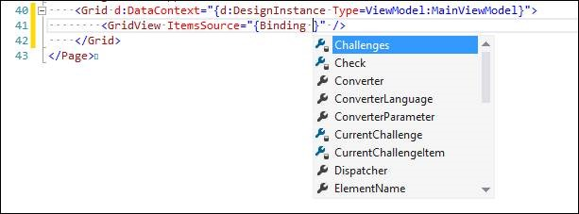
WPF DataContext vs. MVC Model
WPF DataContext

Slide 7
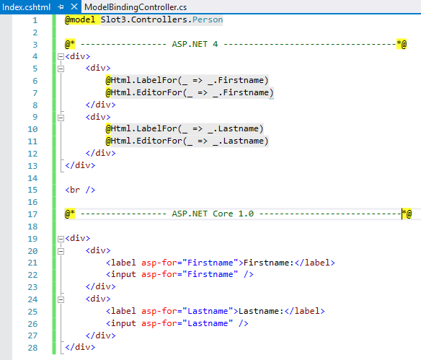
Databinding
Notes:
Install Package Microsoft.AspNetCore.Razor.Tools für Intelli-Sense

Slide 8
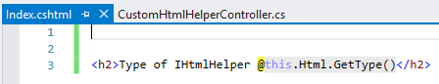
Neue htmlHelper Implementierung

Slide 9
TagHelper
Notes:
Install Package Microsoft.AspNetCore.Razor.Tools für Intelli-Sense

Slide 10
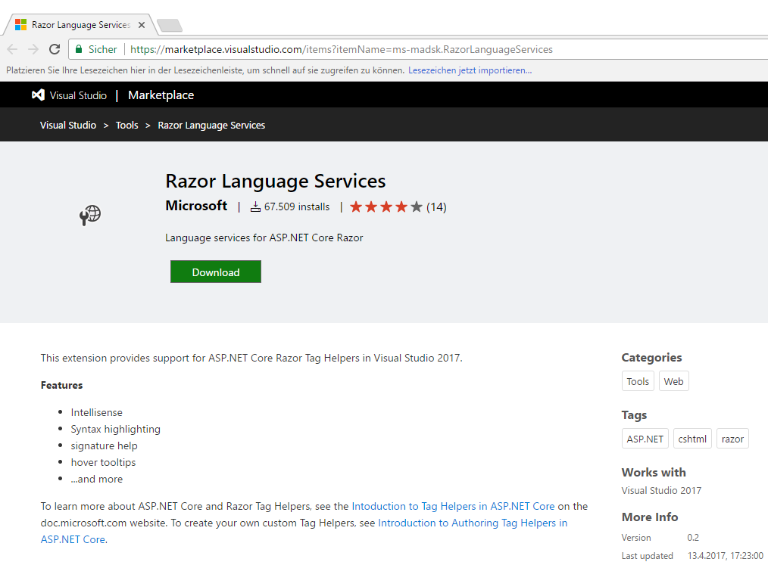
TagHelper
Notes:
Install Package Microsoft.AspNetCore.Razor.Tools für Intelli-Sense

Slide 11
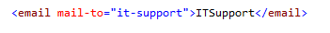
Eigene Tag Helper

Slide 12
View Components
Ähnlich PartialViews
Kein Model gebunden
Überall da sinnvoll wo wiederverwendbarer Inhalt gerendert werde soll
Notes:
-Define an InvokeAsync method that returns an IViewComponentResult
-Typically initializes a model and passes it to a view by calling the ViewComponent View method
-Parameters come from the calling method, not HTTP, there is no model binding
-Are not reachable directly as an HTTP endpoint, they are invoked from your code (usually in a view). A view component never handles a request
-Are overloaded on the signature rather than any details from the current HTTP request

Slide 13
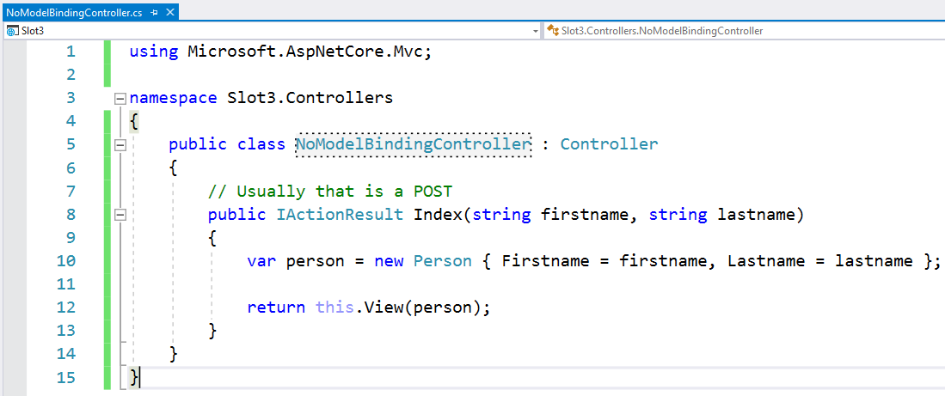
Modelbinding

Slide 14
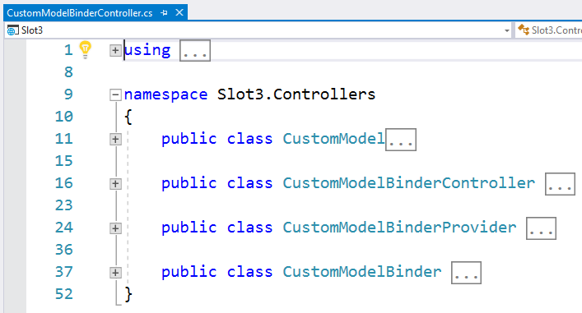
Custom Modelbinder

